Slide 1
Predicting Apple Stock Price
by S Shamtej Rana, Joshua Brown, and Andy Wang
EN.500.115 Gateway Data Science
Spring 2024

Slide 2
Our Goal
1
2
Main Goal
Secondary Goal
Create a model to predict the stock price of Apple for the first two weeks of 2024 using only data from the past 2 years
Incorporate highly correlated (e.g. Google) and/or anti-correlated stock prices (e.g. Ebay) to enhance the prediction

Slide 3
Dataset Sources
All companies analyzed in this project (Apple, Ebay, Google, Meta) are traded on the NASDAQ stock exchange.
Data was collected directly from archives on the NASDAQ’s website.
Apple (aapl) | https://www.nasdaq.com/market-activity/stocks/aapl/historical
Ebay (ebay) | https://www.nasdaq.com/market-activity/stocks/ebay/historical
Google (goog) | https://www.nasdaq.com/market-activity/stocks/goog/historical
Meta (meta) | https://www.nasdaq.com/market-activity/stocks/meta/historical

Slide 4

Data Exploration

Slide 5
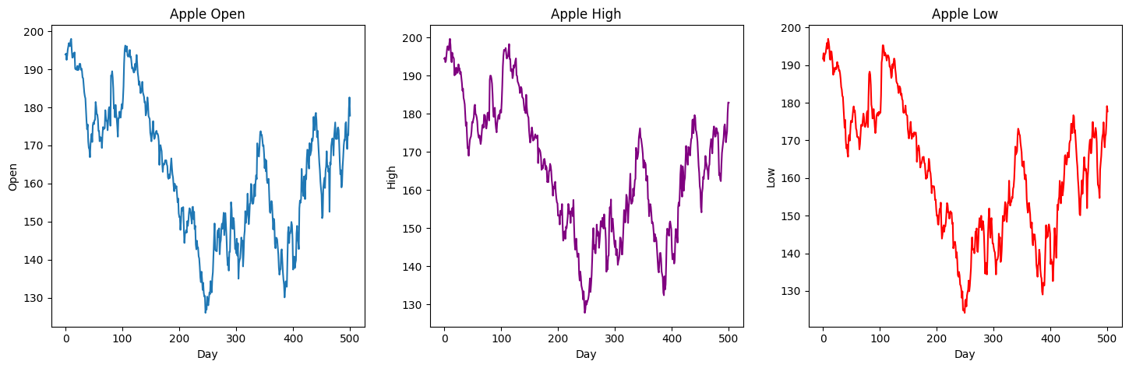
Apple Open, High, and Low Prices

Slide 6
Time Series Analysis
1
2
3
Stationary
Autocorrelation
Trend Decomposition

Slide 7
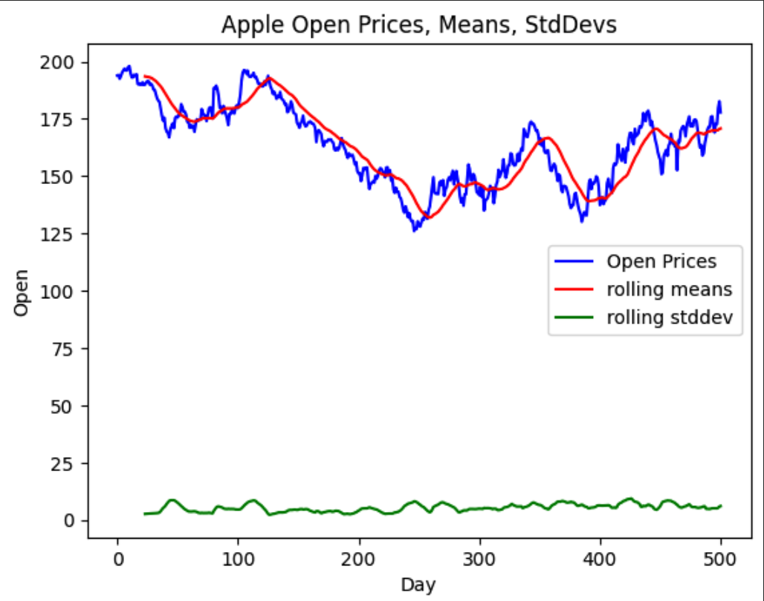
Stationary
A measure of the constantness of the data.
A stationary dataset doesn’t have seasonal patterns or trends.
People buy more shares around holidays, birthdays, the beginning of school years etc.
Use Dickey-Fuller test, after calculating rolling means and standard deviations.
Null hypothesis: Dataset is not stationary
Alternative hypothesis: Dataset is stationary
p-value | 0.2331 | >0.05, data is NOT stationary

Slide 8
Autocorrelation
Autocorrelation tests relatedness of data at successive timesteps.
Lag of step size i tells us how correlated data at timestep k is to data at timestep k-i.
Pretty high autocorrelation values
Tells us that previous values do affect future values to some extent
This makes sense because buy and sell decisions are made based on historical data.
i | Autocorrelation
1 | 0.9865
3 | 0.9619
6 | 0.9278
9 | 0.8907

Slide 9
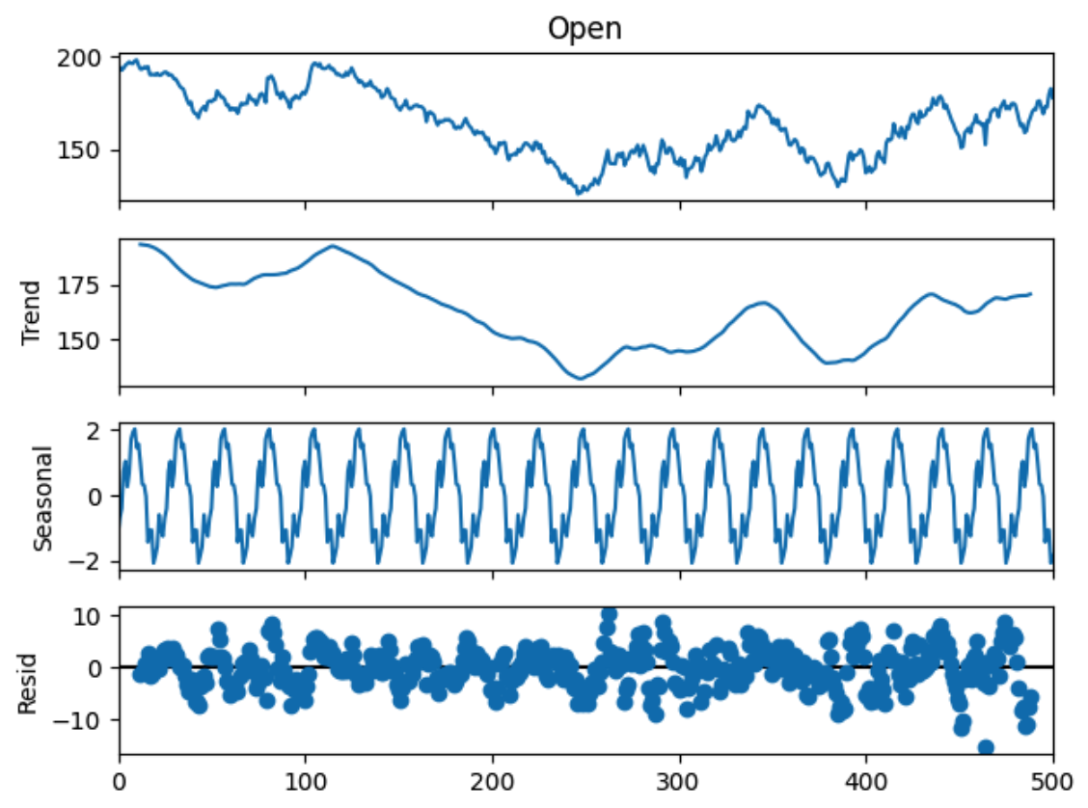
Decomposition
Decomposition
Level - Average value up to a timestep
Trend - Increasing or decreasing value in the series
Seasonality - Repeating short-term cycle in the series
Noise - Extent of random variation in noise.
Shows a high irregularity in trend, because of the high residuals and the unevenness in trend.
Level

Slide 10
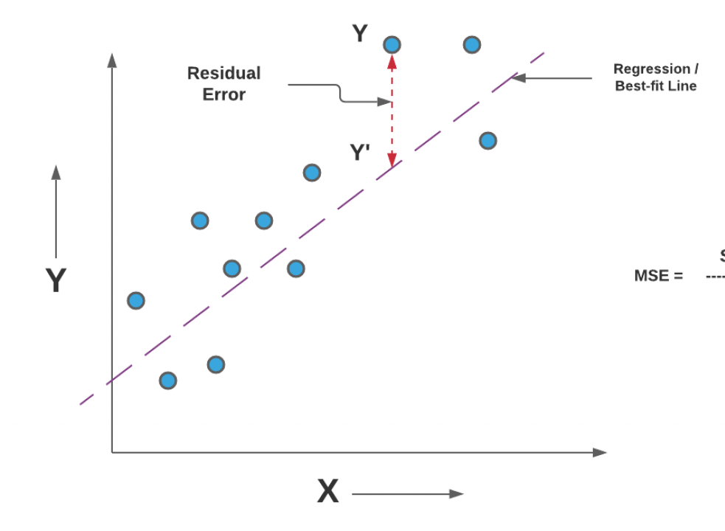
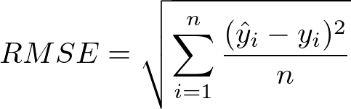

Chosen Evaluation Metric:
Root Mean Square Error (RMSE)
Penalize larger mistakes more greatly than smaller ones.

Slide 11
Modeling

Slide 12
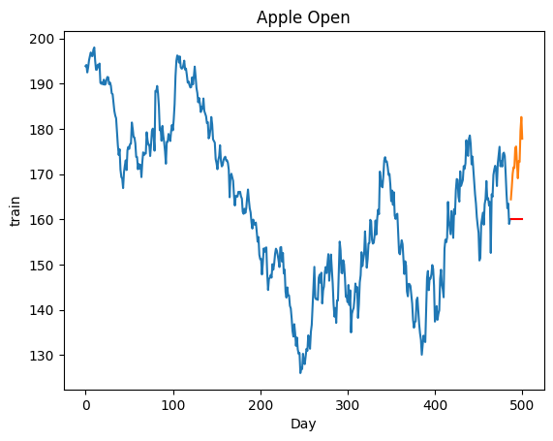
ARIMA model
Autoregressive Integrated Moving Average
Primary Use is for Time Series Data
Unable to be calibrated with our data
Could be because of the trend irregularity.
RMSE: 13.906 (Weak)

Slide 13
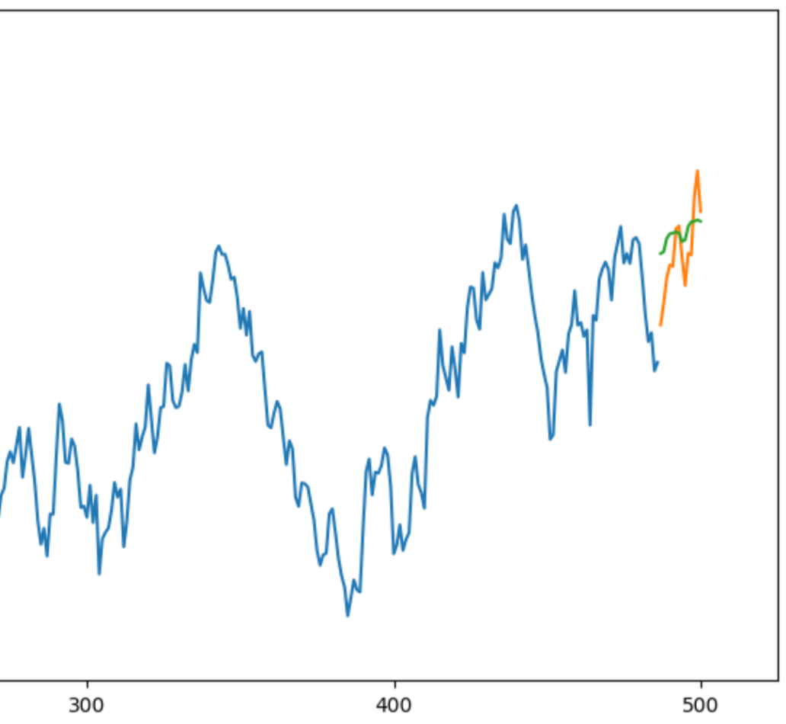
Prophet model
Model created by Meta for Time Series Analysis and other nonlinear data
Chosen due to ability to account for seasonal changes and periodic trends
Performed better than ARIMA but was still not ideal
RMSE: 4.324
(Much better than before)

Slide 14
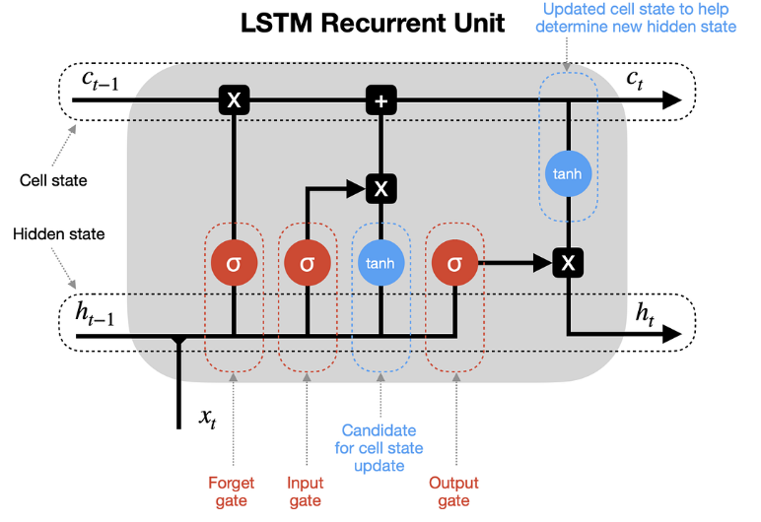
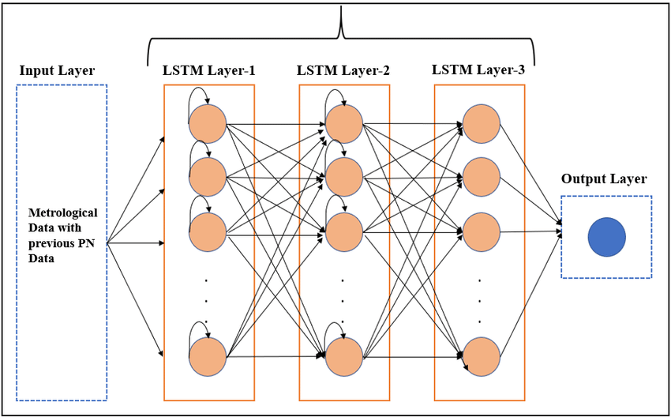
RNN-LSTM Background

Slide 15
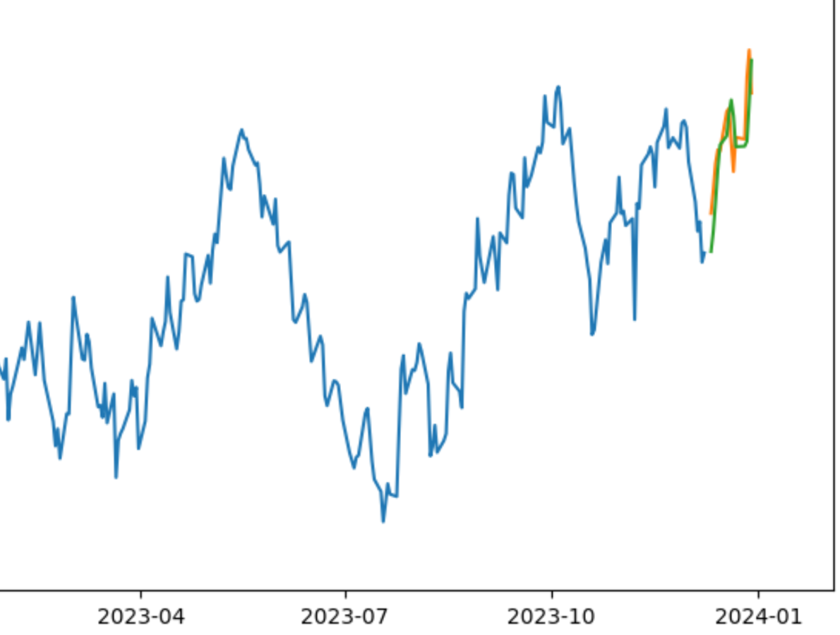
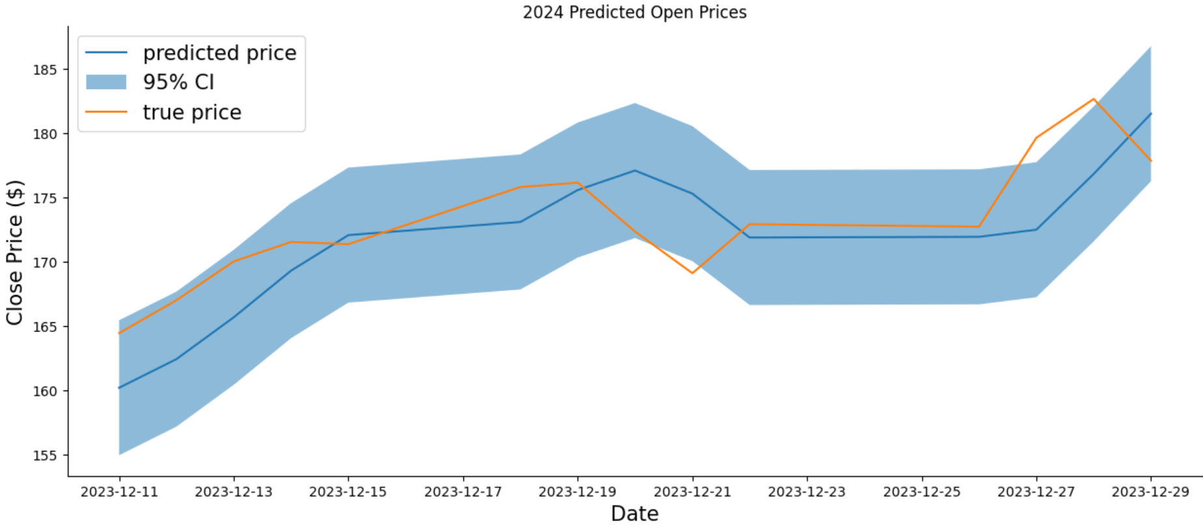
RNN-LSTM Model
Specific type of RNN
Incorporated Long Short Term Memory (LSTM) for time-series data.
Chosen because of ability to consider recent data with more priority than older data
Parameters controlled:
Model Architecture (Number of Layers and Type of Layers), Batch Size, Training Epochs, Optimizer
Loss function was RMSE to standardize our comparison across models

Slide 16
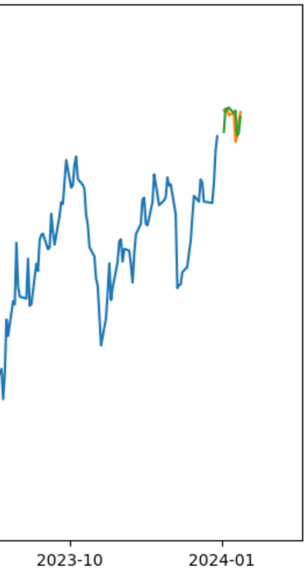
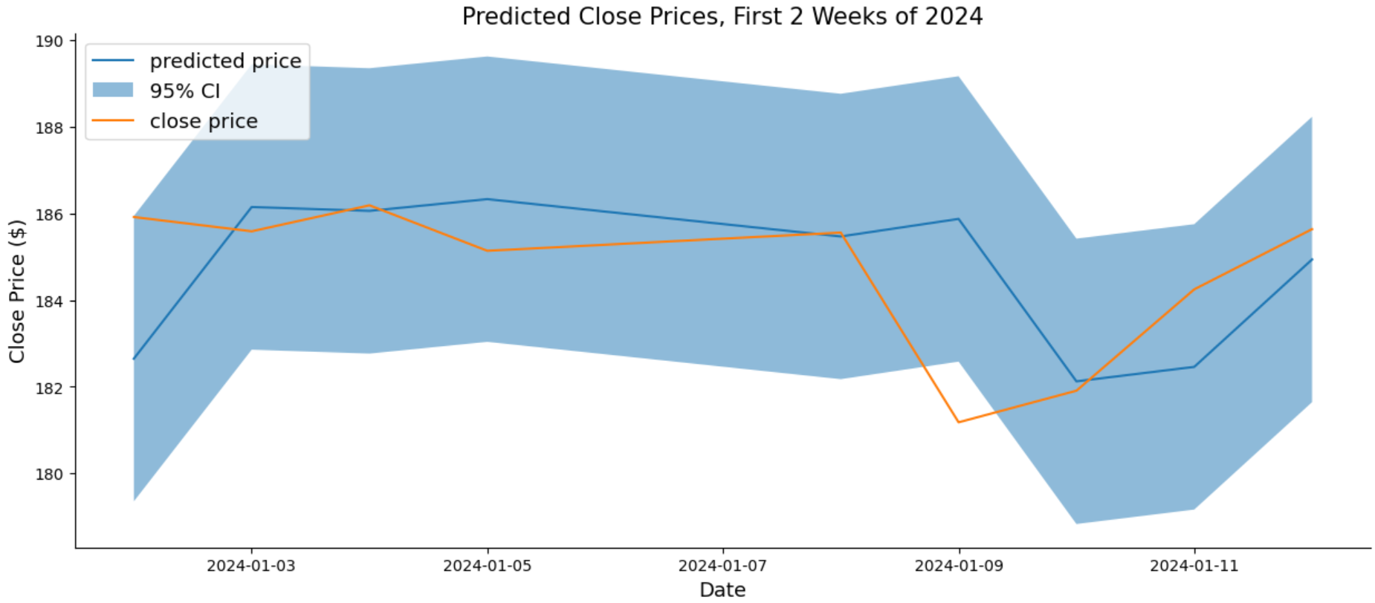
LSTM Close Price Evaluation
RMSE: 2.061 (Very Good)

Slide 17
Summary
RNN+LSTM Benefit
Processing
Data Relevance
RNN+LSTM was a good choice due to its ability to emphasize recent data
Certain hyperparameter changes were necessary to account for time series data (e.g. batch size)
Narrowing time frame window was very important, as year old data isn’t relevant
Stock Data
Black Box
Challenge
Hard to account for seasonal shifts and general “market trends”
Difficult for RNN to understand correlation and anti-correlation
Tough to predict for a full two weeks on one variable (day)

Slide 18
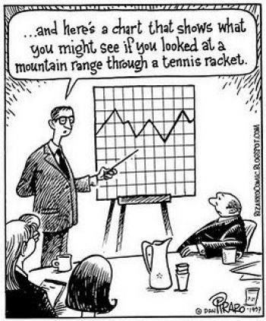

Thanks!
Do you have any questions?

Slide 19
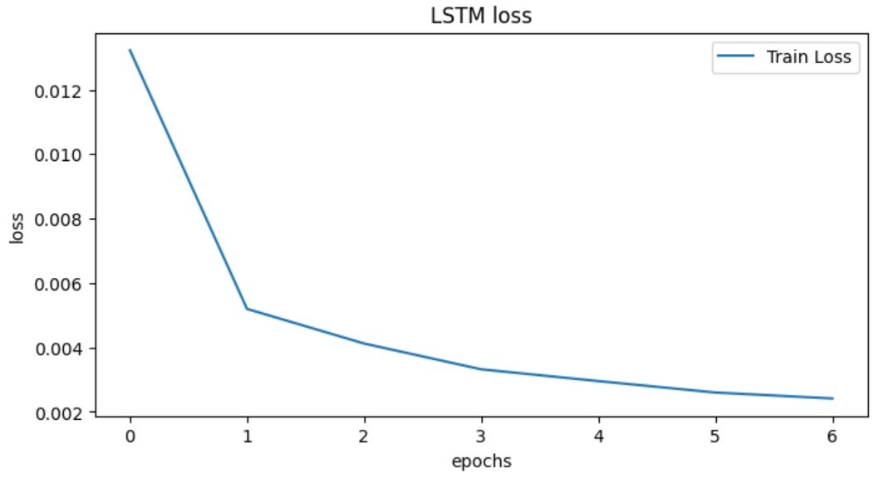
Summary
Used LSTM to predict Apple’s 2024 stock prices
Tried other models, ARIMA and Prophet, but were not as successful
Used grid search to optimize for batch size, epochs, layers, and optimizer
Tried to implement other correlated (and anti-correlated) stock prices, but this did not help

